Slide 1

Website Digg Project
Soraia Felício
Analysis of Social Networks and Information
Professor: Carlos Soares

Slide 2
About the data of the Digg
Each node in the network is a user of the website, and each directed edge denotes that a user replied to another user.
Digg delivers the most interesting and talked about stories on the Internet right now.

Slide 3
Statistics and Informations of the Digg of the Konect - Koblenz network collection
Informations initial about Network
Category: communication
Nodes (users): 30,398
Edges: 87, 627

Slide 4
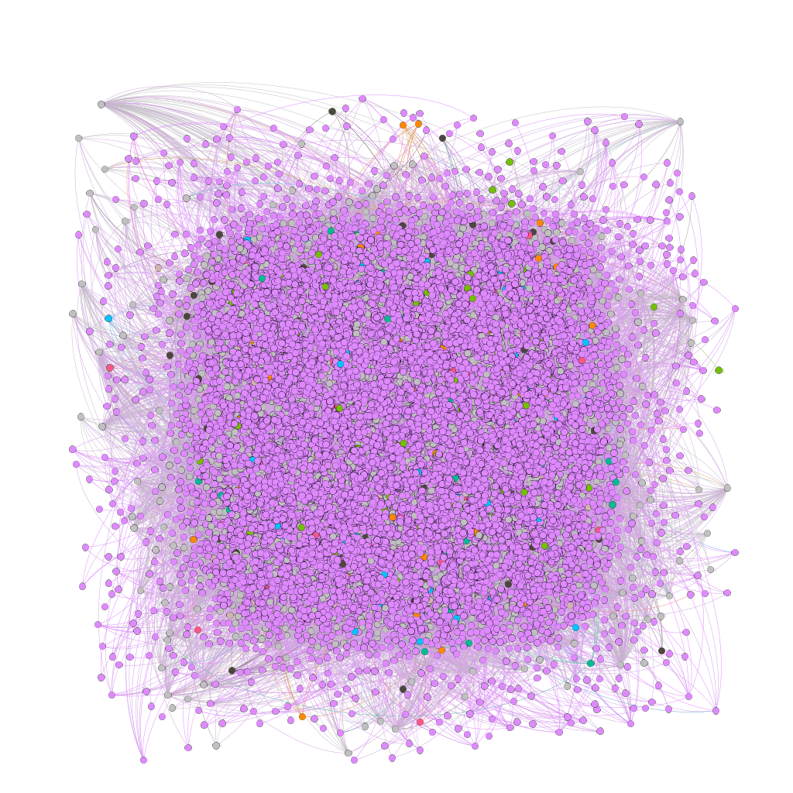
Original graph from network social Digg
Graph presentation from the initial informations (nodes and edges quantity) without filters
Tool of analysis: Gephi
very confused and difficult to visualize and understand

Slide 5
Working with the data of the file
How import the data? It is import to right analysis.
First, attention to the readme file, which informs what is in each file and column of the file that it will be imported.
In this case, for example, open the file "README.munmun_digg_reply" in any edition tools:
Files:
meta.munmun_digg_reply => Metadata about the network
out.munmun_digg_reply => The adjacency matrix of the network in space separated
values format, with one edge per line
The meaning of the columns in out.munmun_digg_reply are:
First column: ID of from node
Second column: ID of to node
Third column: edge weight
Fourth column: timestamp of the edge

Slide 6
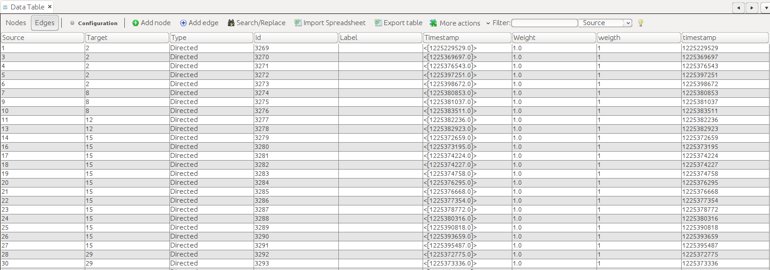
Working with the data of the file
Data Laboraty
Case necessary, open the file imported in edition tools and change the name of the columns.
The original data imported for Gephi tool:

Slide 7
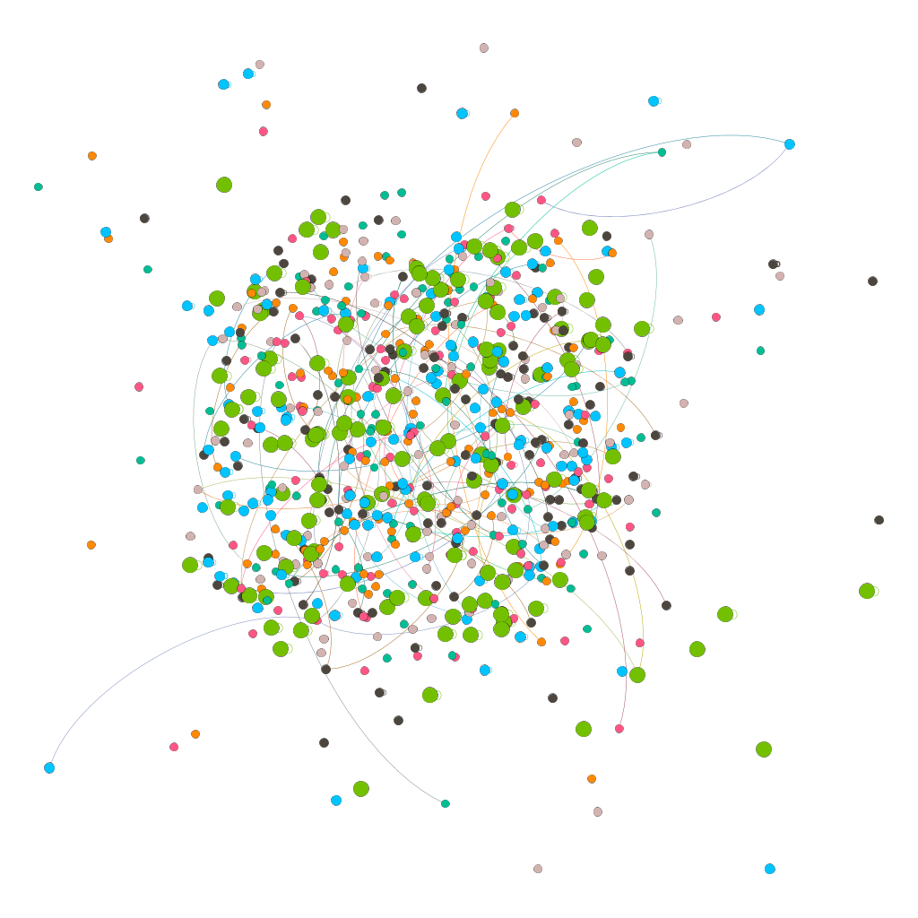
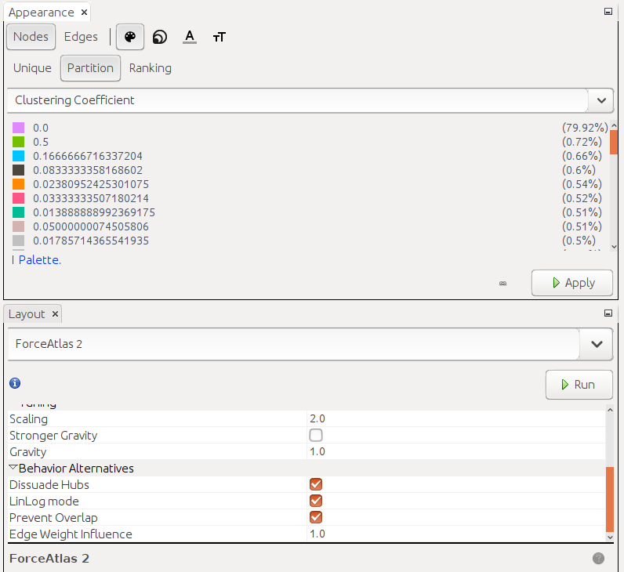
Graph applying filters in the nodes

Slide 8
Triadic Closure
The nodes sizes differents for nodes with possibility of form triangles.
What is triadic closure?
If two people in a social network have a friend in common, then there is an increased likelihood that they will become friends themselves at some point in the future.
For example: if nodes B and C have a friend A in common, then the formation of an edge between B and C produces a situation in which all three nodes A, B, and C have edges connecting each other — a structure we refer to as a triangle in the network. The term “triadic closure” comes from the fact that the B-C edge has the effect of “closing” the third side of this triangle.
A
B
C

Slide 9
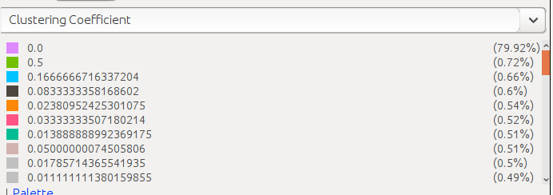
Clustering Coefficient
Analysis about clustering coefficient (Chapter 3, page 49):
79.92% none node's friends are friends with each other (is showed in the pink color);
0.72% has about 0.72 of the nodes's friend are friends with each other (is showed in the green color);
0.66% has about 0.17 of the node's friend are friends with each other (is showed in the blue color)
this same analysis is performed with the other colors
The Clustering Coefficient of a node A is defined as the probability that two randomly selected friends of A are friends with each other.

Slide 10
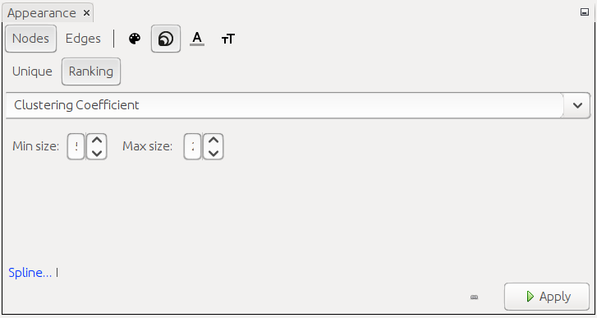
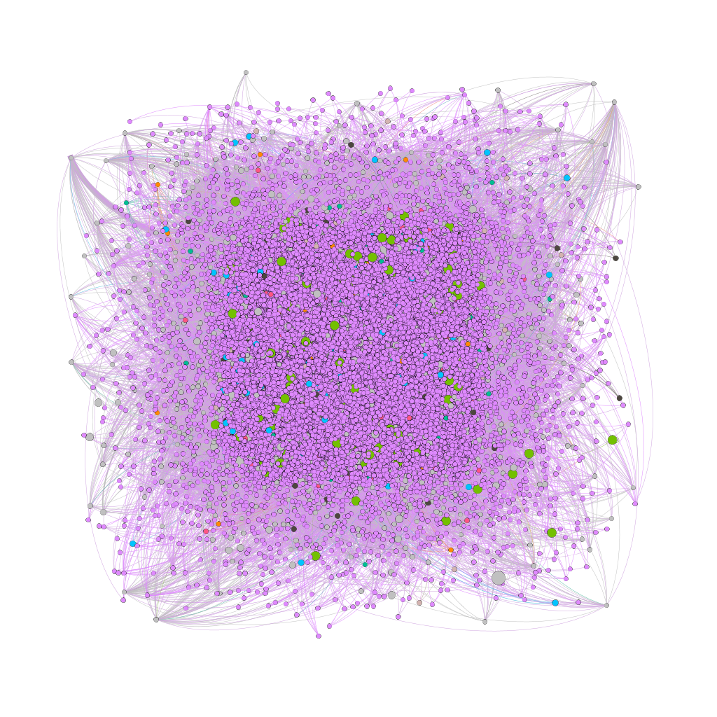
Clustering Coefficient
Without filters
10
30
Applying only configurations

Slide 11
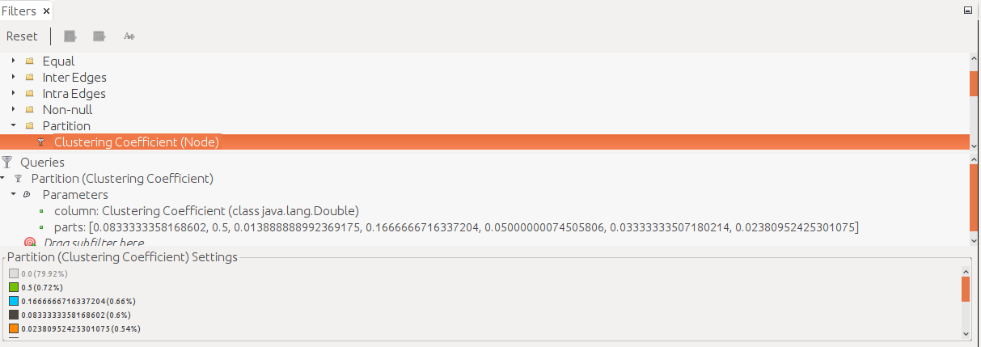
Clustering Coefficient with filter
with filters
Interpretation in relation to this Project:
The evaluated dataset represents the action over time of network users. These actions are communication through messages between them. In this case, the probability of these actions between two users, connecting a third node, is seen through the green nodes, which seem to demonstrate a greater probability of forming these triangles represent.

Slide 12
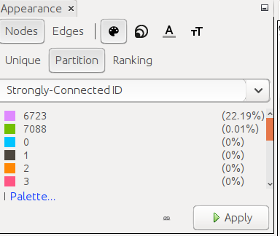
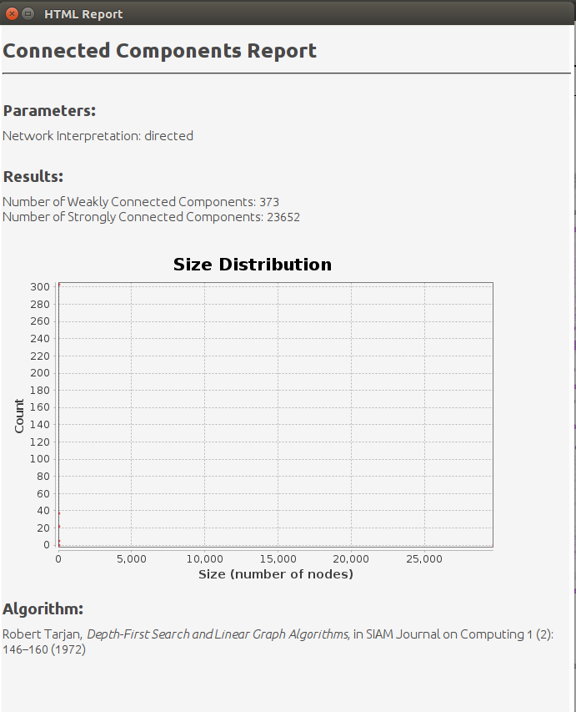
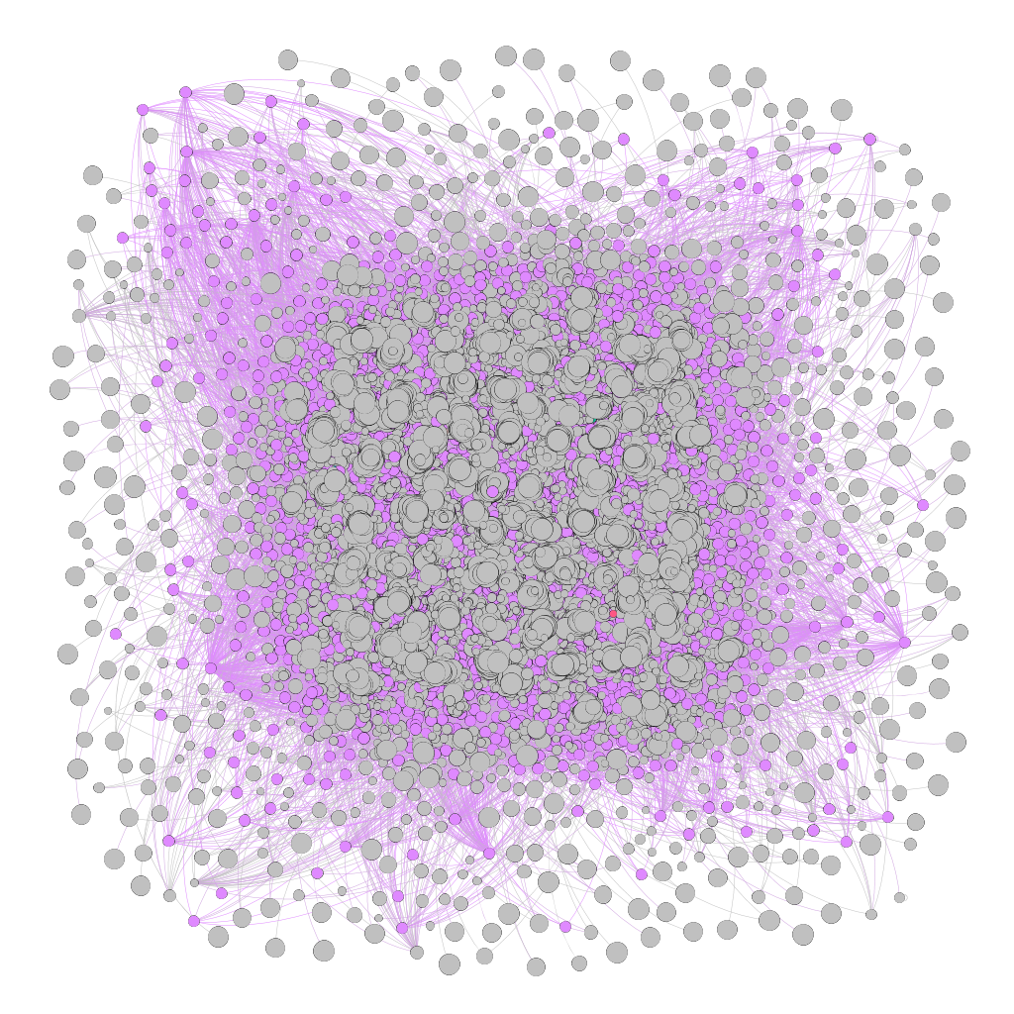
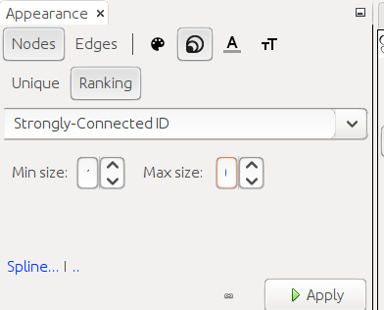
Connected component
Without filter
10
30

Slide 13
Connected component and Local Bridge
Without filter
If a node satifies Strong Triadic Closure and is involved in at least two strong ties, then any local bridge it is involved in must be a weak tie. The figure illustrates the reason why: if the A-B edge is a strong tie, then there must also be an edge between B and C, meaning that the A-B edge cannot be a local bridge. Chapter 3, page 55, fig 3.6.
Interpretation about Local Bridge in relation to this Project:
The graph on the side shows the application of the statistically strong connection between the nodes, which is shown both by the highlight of the pink color and the size of the nodes. Therefore, the Digg social network in the context of communication between users has several local bridges represented by the larger nodes, which represent the strong ties and by the smaller nodes, which represent the weak ties. The latter are responsible for local bridges.

Slide 14
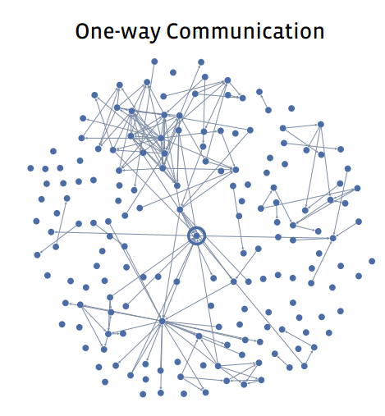
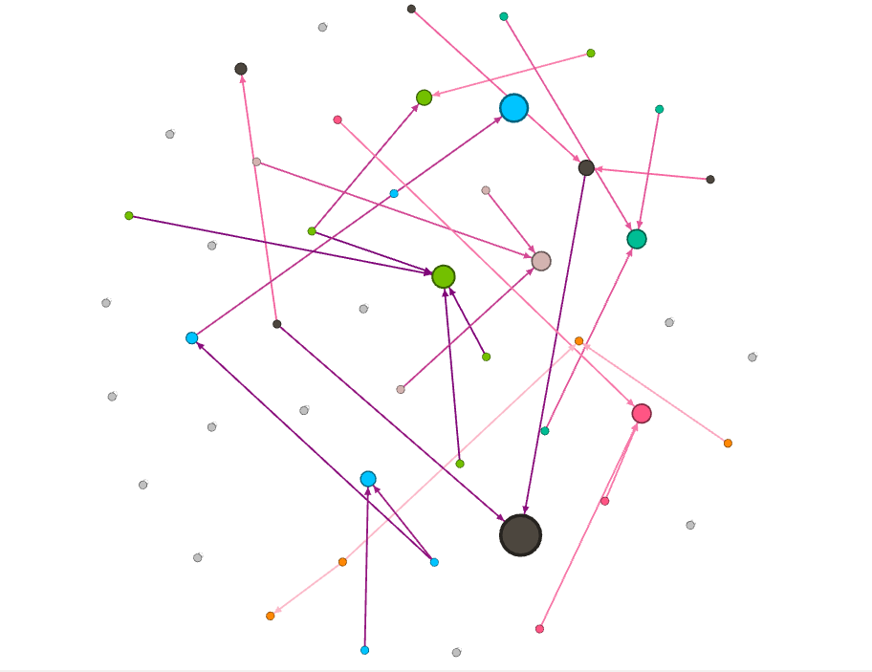
Tie Strength
Facebook
Digg
If the user sent one or more messages to the friend at the other end of the link (whether or not these messages were reciprocated). Chapter 3, page 61.
Configuration applying in the Gephi tool: nodes color - modularity class, nodes size - eigenvector centrality min 10 and max 50. Edges - ranking - timestamp; with filter - modularity class.

Slide 15
Tie Strength
Facebook
Digg
Interpretation: The metric “modularity class” organizes in group or class. The groups nodes are highlighted by nodes. Likewise, on Facebook, in this analysis, we observed that Digg has users who send messages, regardless of whether or not they have replies to the messages sent. The graph above demonstrates this context through the size of the nodes that demonstrates the central nodes and the colors shows the creation of a group. Connections between users are shown over a period of time using different colors.

Slide 16
Embeddedness
What stands out about A, similar to the node shown at the side, inserted in the subset of the social network Digg analyzed at the side, is the way in which all of his edges have significant embeddedness.
A long line of research in sociology has argued that if two individuals are connected by an embedded edge, then this makes it easier for them to trust one another, and to have confidence in the integrity of the transactions (social, economic, or otherwise).
No similar kind of deterring threat exists for edges with zero embeddedness, since there is no one who knows both people involved in the interaction.
Chapter 3, page 66
Interpretation in relation to this Project:
Node A and others, that they represent some users, in this subset of the Digg, that have linking between them can be considered embeddedness, but there are some users, represented by nodes in the color gray, por exemplo, in this subset that have zero embeddedness, because they have not involved in the interaction with others users.
A
It's the same subset of the previous Digg.

Slide 17
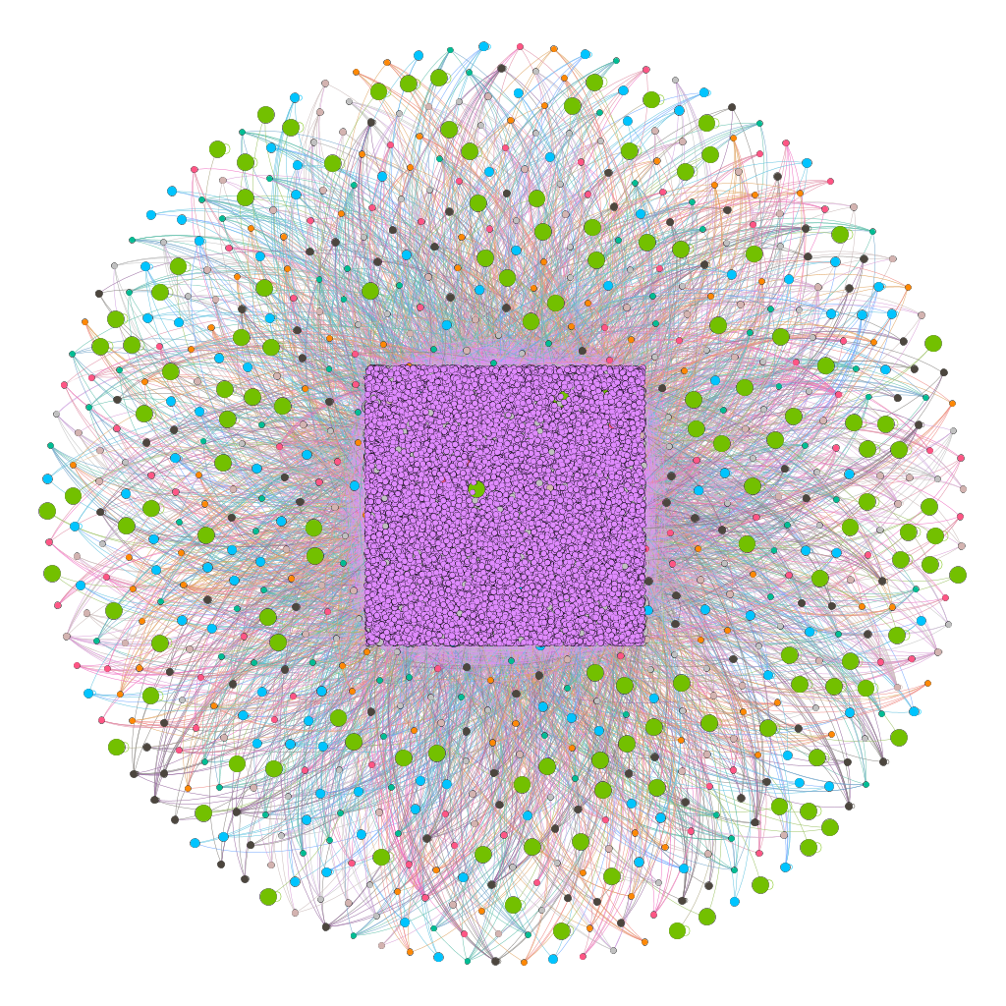
Homophily of the Digg
Homophily can produce a division of a social network into densely-connected, homogeneous parts that are weakly connected to each other.
Interpretation in relation to this Project.
Digg is a social network that highlights news according to users' votes. In the context in the applicable data is just messages sent to other users that may be related to a news story. Recalling that a news item is not included in this dataset, but perhaps it is the point of interest and that arouses a similarity among these users.

Slide 18
Balance Theorem
General balancing conditions :
(i) Every two nodes in X are friends.
(ii) Every two nodes in Y are friends.
(iii) Every node in X is an enemy of every node in Y
Chapter 5, pg 124
Weakly Balanced Networks:
There is no set of three nodes such that the edges among them consist of exactly two positive edges and one negative edge.
Chapter 5, pg 130.

Slide 19
Structural Balance in Arbitrary (Non-Complete) Networks
Identifying supernodes (two steps):
To convert the graph to a reduced one in which there are only negative edges: each supernode is connected internally via positive edges, and the only edges going between two different supernodes are negative. (If there were a positive edge linking two different supernodes, we should have combined them together into a single supernode.)
To solve the problem on this reduced graph: the application procedure Breadth-First Search of the Reduced Graph (only negative edges go between supernodes (since a positive edge between two supernodes would have merged them together into a single one). As a result, our reduced graph)
Balance for General Network:
A signed graph is balanced if and only if it contains no cycle with an odd number of negative edges.
Chapter 5, pg 137
How to identify this odd number of negative edges? Identifying Supernodes.

Slide 20
Approximately Balanced Networks
Original Balance Theorem + theorem relaxed:
Let ε be any number such that 0 ≤ ε < 1 8 , and define δ = √3 ε. If at least 1 − ε of all triangles in a labeled complete graph are balanced, then either:
(a) there is a set consisting of at least 1 − δ of the nodes in which at least 1 − δ of all pairs are friends, or else
(b) the nodes can be divided into two groups, X and Y , such that (i) at least 1 − δ of the pairs in X like each other, (ii) at least 1 − δ of the pairs in Y like each other, and (iii) at least 1−δ of the pairs with one end in X and the other end in Y are enemies.
Chapter 5, pg 144

Slide 21
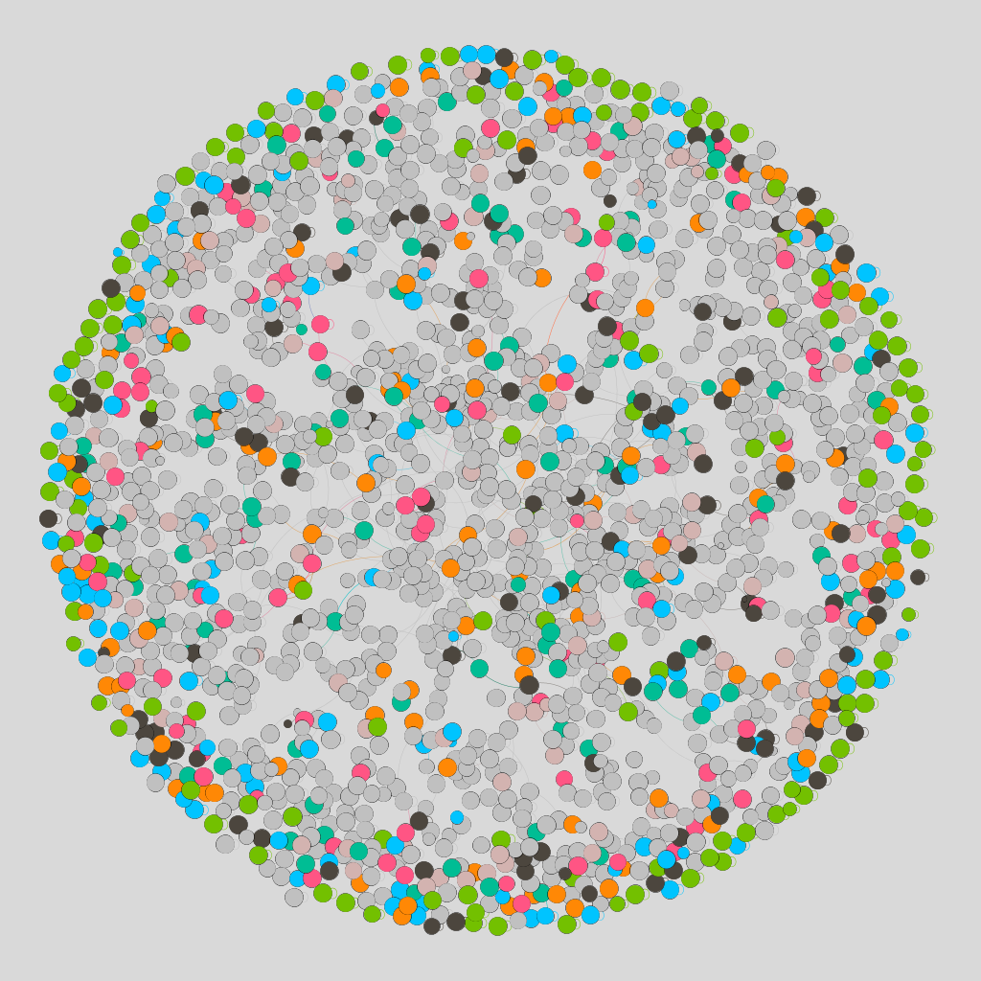
Weakly Balanced Networks
Interpretation in relation to this Project:
Therefore, Digg can be considered structurally, in the context of this dataset analysed which refers to the exchange of messages between network users, a weakly balanced network or approximately balanced.
According to the previous definition on weakly balanced networks, there is no set of three nodes, so that the edges between them consist of exactly two positive edges and a negative edge, in more than 90% of their nodes, since the visibility of the graph above after applying the filter (clustering coefficient) only to nodes with significant values, it is 6.22% of nodes.
Analysis of the Digg graph: the size of the node is how much it is connected (good node) and the filter is applied to those that have some Clustering Coefficient (related to the pairs are friends). It was applied a clustering coefficient like filter and in the nodes color and in the size of the node was applyind the metric "strongly connected" to evaluate the formed triangles.

Slide 22
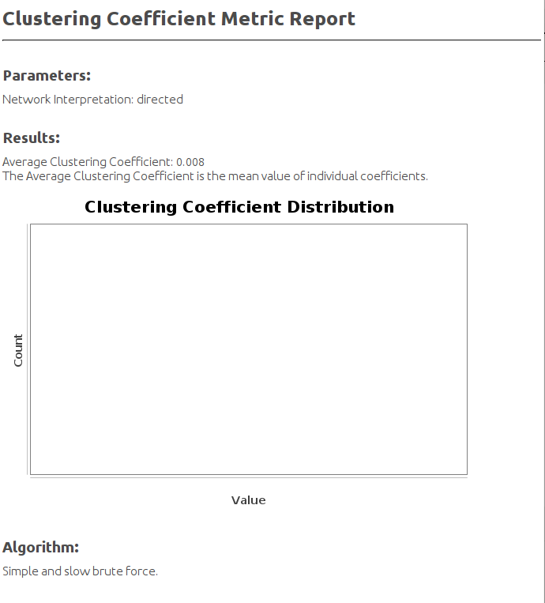
Approximately Balanced Networks
Interpretation in relation to this Project:
Or by the definition of approximately balanced as there is 6.22% of triangles in this evaluated network so there may be at least 1 balanced triangle that allows has at least 1 - ε of all triangles in a labeled complete graph are balanced, as shown by the coefficient clustering average report alongside, equal 0.008, then either: at least one of the nodes contains at least 1 - δ of the nodes where at least 1 - δ of all pairs are friends and can be divided into two groups (X and Y) where at least one of the pairs are friends in X and enemies in Y.

Slide 23
References
Data source: http://konect.uni-koblenz.de/networks/munmun_digg_reply
Easley, D, and Kleinberg, J. Networks, Crowds, and Markets: Reasoning about a Highly Connected World. Cambridge University Press, 2010.

